Slide 1


Knowledge Graphs
Wooftology: Dog Breeds Unleashed
Alkiviadis Kariotis
Ioanni Tsaka
Maria Varna
Instructor: Dr.Georgios Drakakis
July 2024

Slide 2

Paw your way into our Ontology
Data & Ontology
In Depth Protege
Properties & Restrictions
Queries & Results
Future work & Conclusion

Slide 3

Data & Ontology

Slide 4
Resource and Software
The Dataset was derived from Kaggle
The original set contained 19 columns, some of them were not used while building the ontology
The idea was to create a structure, based on dog breeds and their characteristics
Protégé was used to create the ontology, define the classes, the properties, the individuals and the relationships between them
After creating the basic entities, individuals were added to represent instances on specific classes

Slide 5
Basic Concepts
There are two main classes in the ontology : Dog and Characteristics
Dog contains all the different breeds. In total 87 breeds were used
All Dog Breeds (e.g. Pug, Golden Retriever) are a unique Subclass of Dog
Some Breeds have additional subclasses (e.g. Setter has a subclass of EnglishSetter, GordonSetter and IrishSetter)
The class Characteristics have 8 subclasses : Genetic Ailments, Grooming Frequency, Intelligence, Life time Cost, Longevity, Size, Suitability for children and Type
Individuals represent specific instances that belong in a certain class
Queries produced to match certain demands in a dog to the appropriate breed

Slide 6
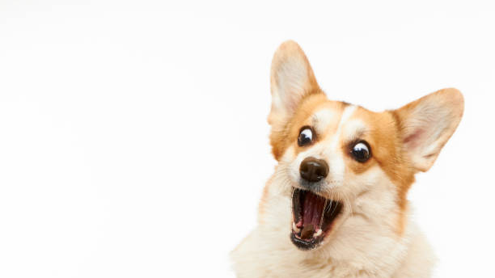
IN DEPTH PROTEGE

Slide 7
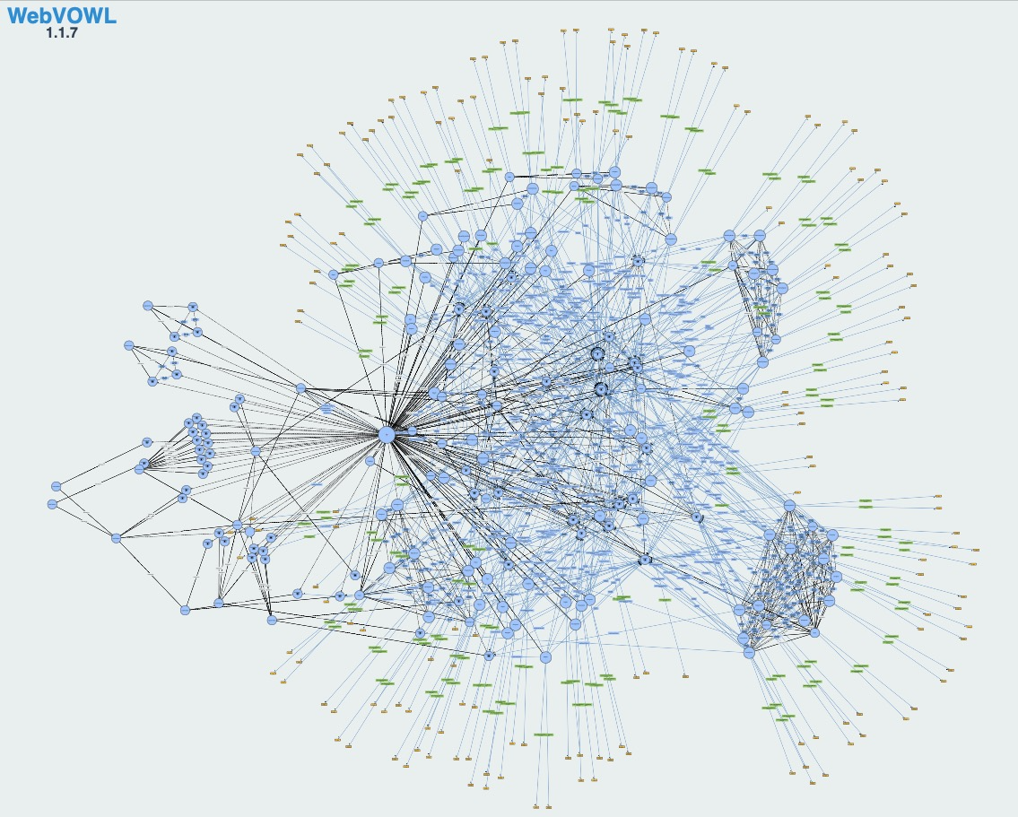
A visual graph of the whole ontology,generated from WebVOWL

Slide 8
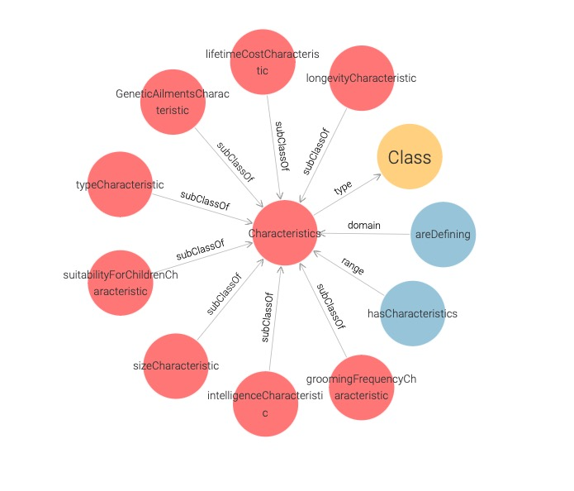
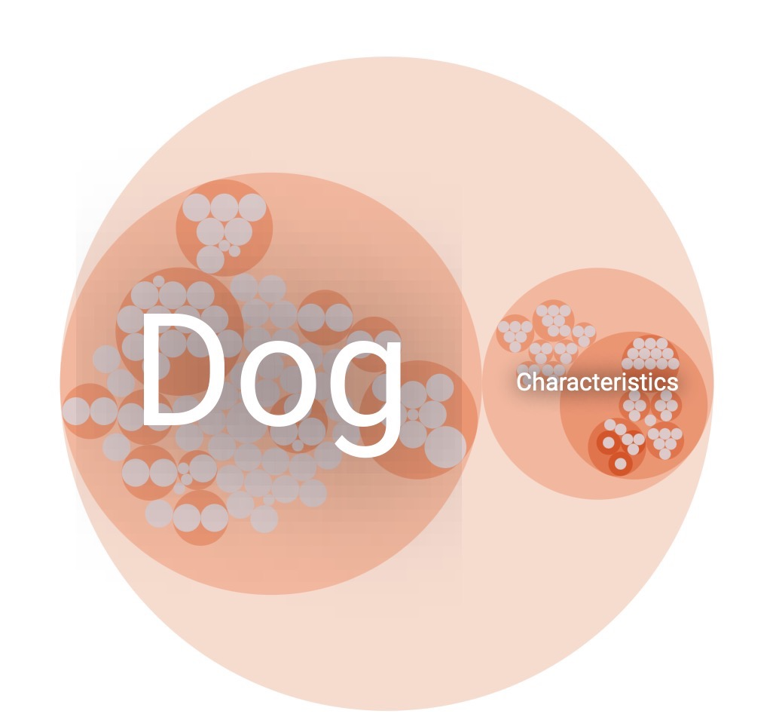
Dog and Characteristics as Superclasses
A schema based on the Characteristics class
Contains the associated Subproperties and ObjectProperties

Slide 9
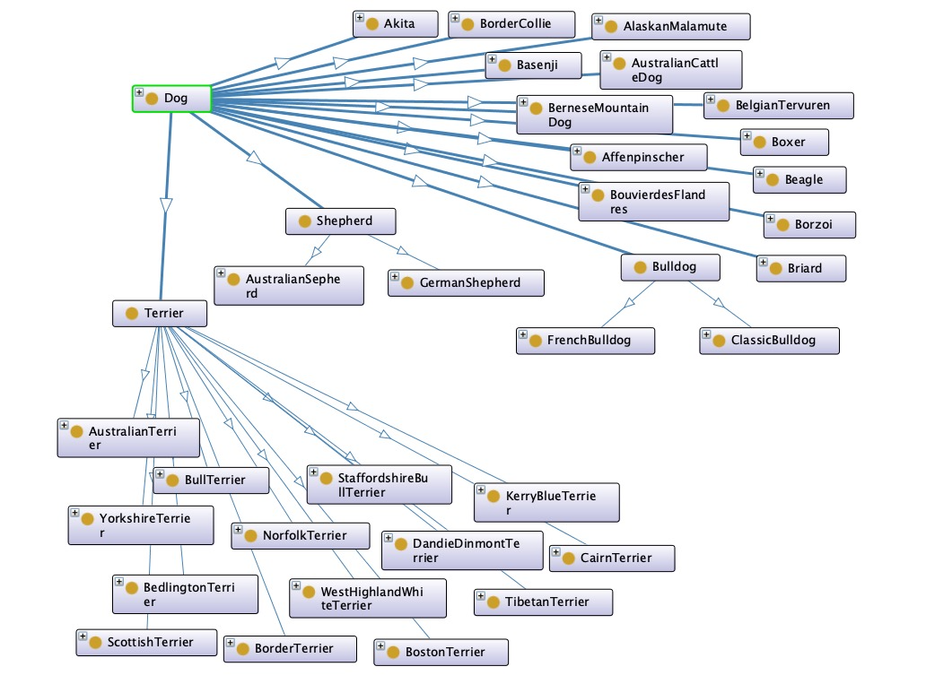
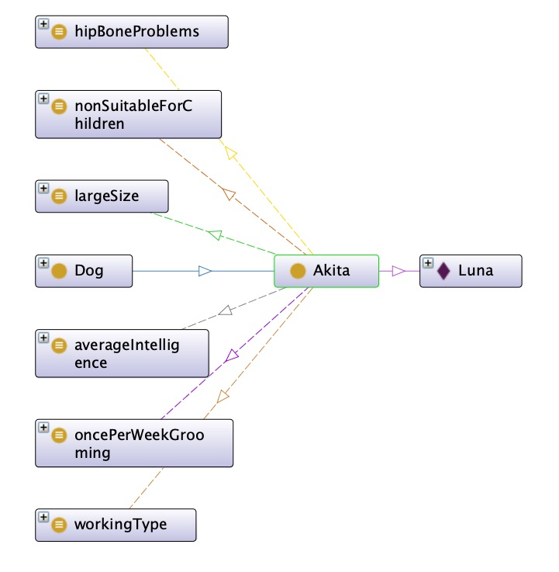
Example of an individual schema
Luna is defined as a Dog and has specific characteristics
The class of Dog spreading towards every breed. Some breeds also have subclasses enhancing the depth of the ontology

Slide 10
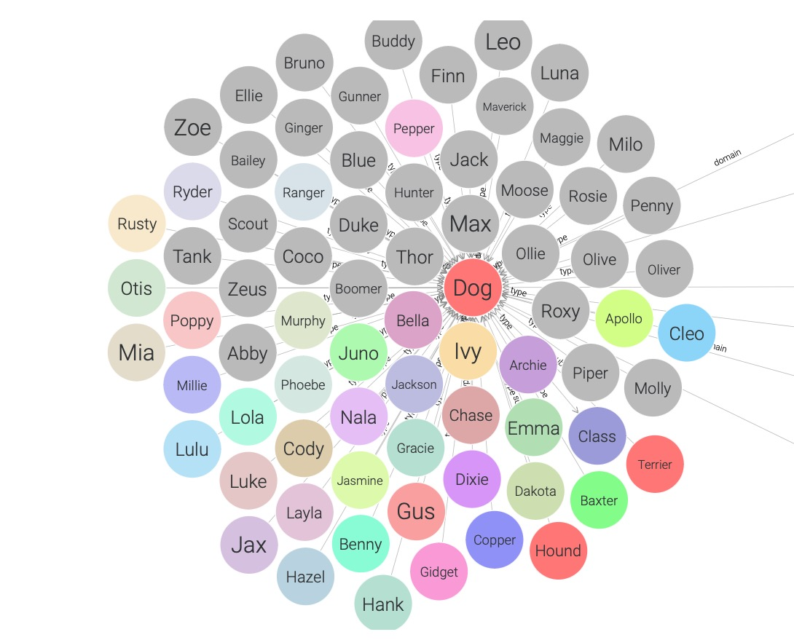
Everyone is here!!!
A graph shows all individuals, generated from GraphDB

Slide 11
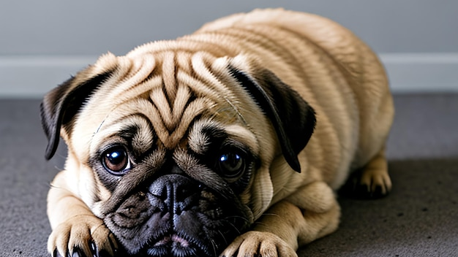
PROPERTIES AND RESTRICTIONS

Slide 12
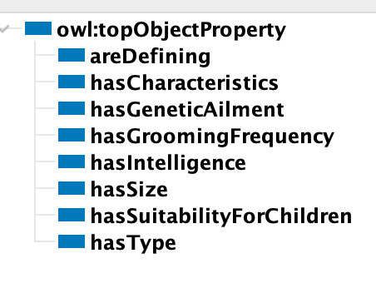
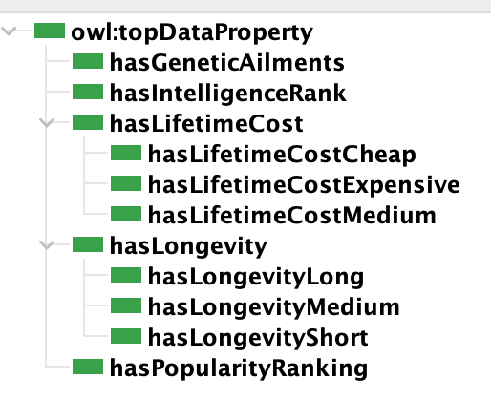
8 ObjectProperties
5 DataProperties and 6 SubProperties
RESTRICTIONS
Defined Classes
Individuals

Slide 13
hasToBeExplained
Object Properties : every Object Property was used to describe relationships between individuals or instances
AreDefining : states that the Characteristics are definig the Dogs
HasCharacteristics : states that every Dog has some Characteristics
HasGeneticAilment : connects a specific Breed with a corresponding Genetic Ailment
HasGroomingFrequency : connects a specific Breed with their grooming Frequency
HasIntelligence: connects a specific Breed with their Intelligence Status
HasSize: connects a specific Breed with the Size they belong
HasSuitabilityForChildren : clarifies if a specific Breed is suitable or not for children
HasType: describes the type of each Breed of the Dog Class

Slide 14
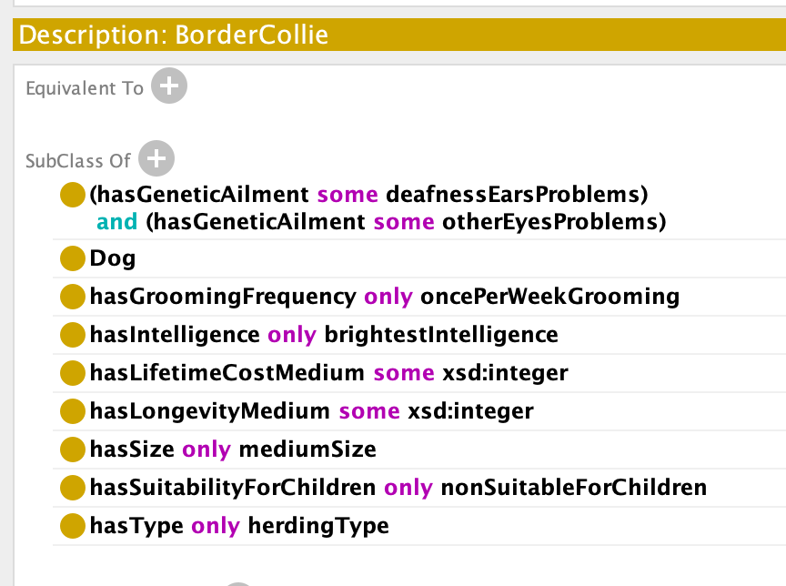
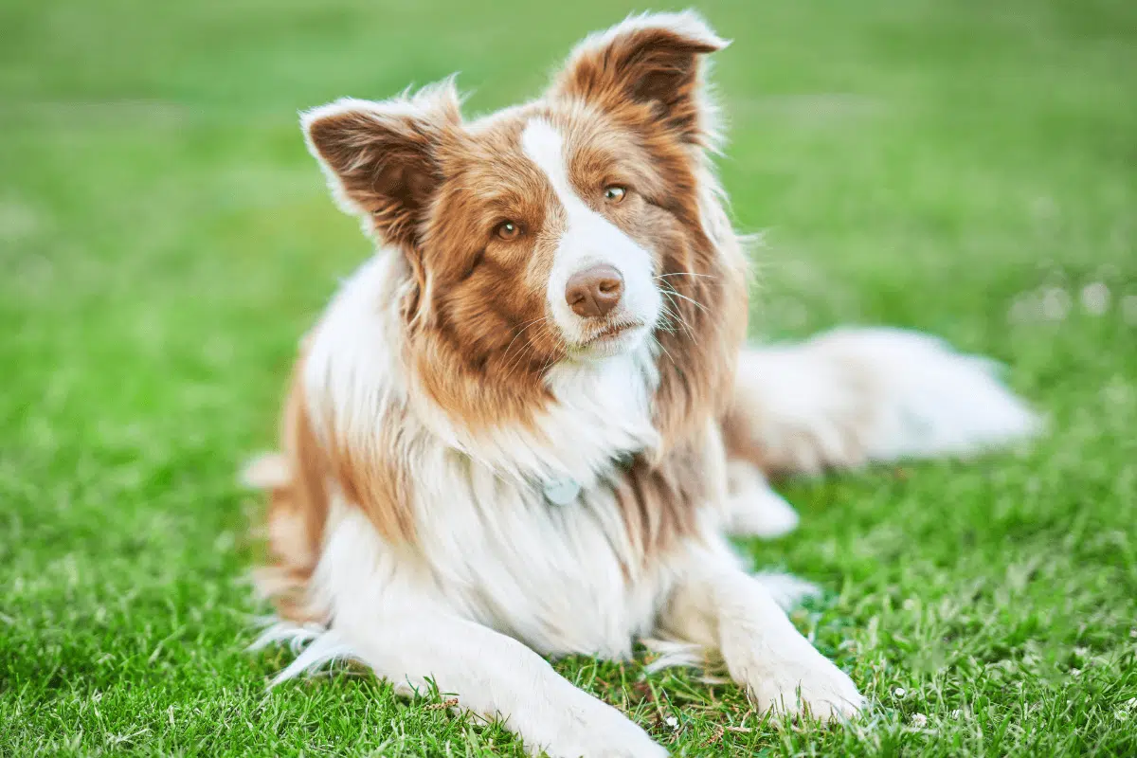
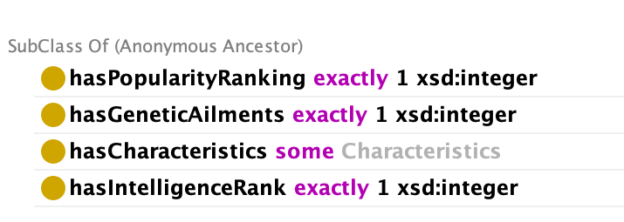
Restrictions used to constraint the relationships between individuals and get inferences based on the characteristics of each subclass
What defines me?

Slide 15
Data Properties : every Data Property describes a relationship between an entity instance to some literal datatype value
HasGeneticAilments : defines the number of Genetic Ailments in each individual Dog
HasIntelligenceRank : defines the range of Intelligence in each individual Dog
HasLifetimeCost : defines the cost in each individual dog through their lifetime. It has 3 SubProperties : 1) Cheap 2) Expensive 3) Medium. In order to fit the costs to the subclasses a range was created:
Cheap | 3.000-18.000€
Medium | 8.001-23.000€
Epxensive | 23.001-27.000€

Slide 16
HasLongevity : defines the Longevity of each individual Dog. It has 3 SubProperties :
1) hasLongevityLong 2) hasLongevityMedium 3) hasLongevityShort
In order to fit the lifetime of each breed a range was manifactured :
Long | 4-17 years
Medium | 10-13 years
Short | 6-9 years
HasPopularityRanking : defines the popularity ranking that each individual Dog has
xsd:integer

Slide 17

QUERIES & RESULTS

Slide 18

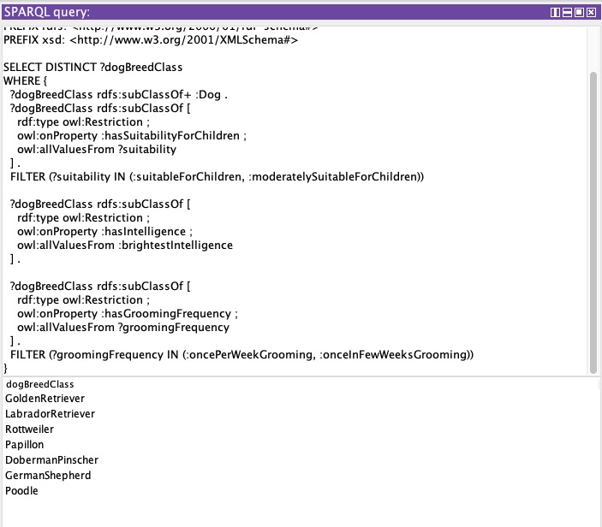
Several SPARQL Queries created to categorize specific attributes based on owner's needs
This Query retrieves which Breeds
are at least moderately suitable for children & suitable for Children
have bright intelligence
do not need daily grooming
PREFIX : <http://www.semanticweb.org/alkis/ontologies/2024/6/untitled-ontology-5#>
PREFIX rdf: <http://www.w3.org/1999/02/22-rdf-syntax-ns#>
PREFIX owl: <http://www.w3.org/2002/07/owl#>
PREFIX rdfs: <http://www.w3.org/2000/01/rdf-schema#>
PREFIX xsd: <http://www.w3.org/2001/XMLSchema#>

Slide 19
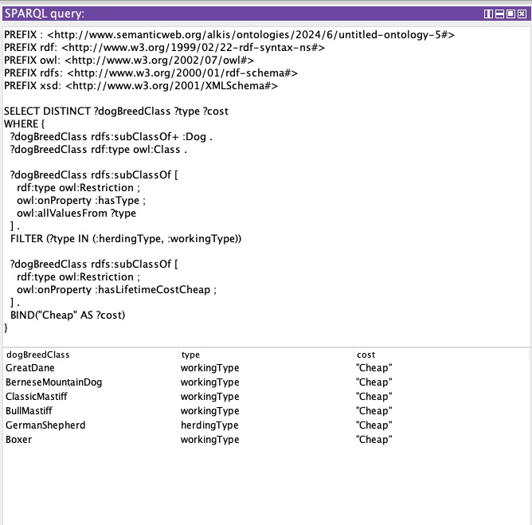
This Query retrieves all Breeds that correspond to:
either working or herding type
have "cheap" as lifetime cost

Slide 20
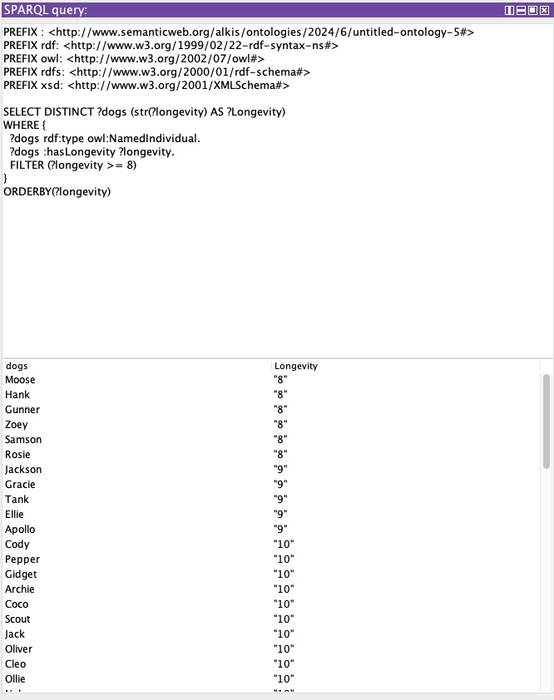
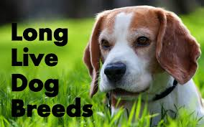
This Query matches all individuals that have longevity > 8 and display them in ascending order

Slide 21
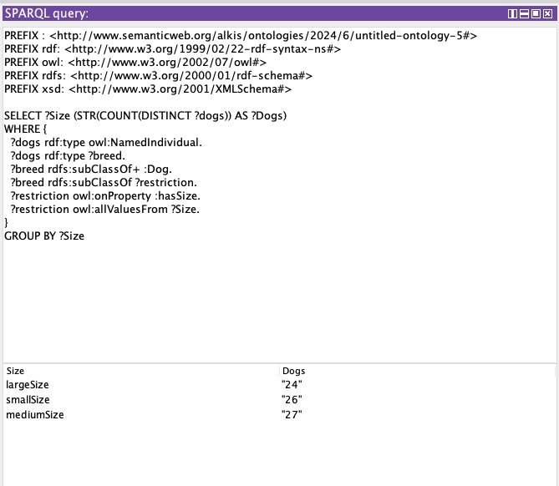
This Query counts the number of individuals for every size category and group the result by size
For example there are 24 dog individuals categorized as largeSize

Slide 22
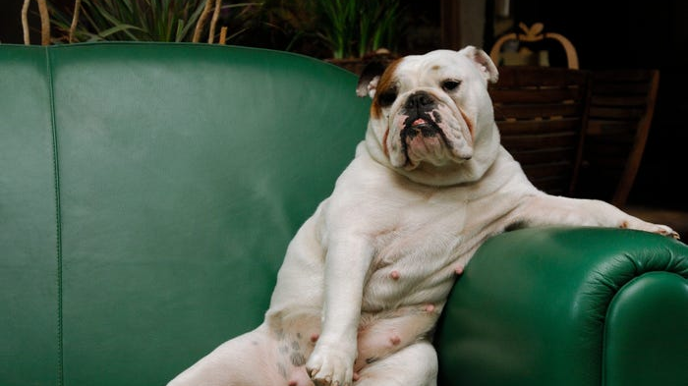
CONCLUSION & FUTURE WORK

Slide 23
CONCLUSION
The created ontology is paws-itively packed with a variety of breeds and connects them with the qualities or flaws of each dog
It successfully connects individuals of dogs with characteristics and breeds
The graphic illustrations provided a more understandable representation of the ontology
With SPARQL Queries more complex insights were extracted

Slide 24
FUTURE WORK
It would be fur-tastic to fur-ther explore more of their attributes and insert more classes ​
For example, in the original set we spotted additional interesting Characteristics such as how likeable each breed is and how the purchase prices​ range
Due to computational difficulties and of lack of time we didn’t get the chance to explore all of them​
Use this knowledge base as a starting point to linking it with similar ontologies, established or not, based on animals and draw conclusion for their characteristics

Slide 25

THANK YOU!
Questions?

